Slide 1
Contract Lecturer Monthly Claims System
ST10445832
Alex Pluddemann
PROG6212

Slide 2
CMCS Purpose
To allow contract lecturers to easily make claims to the institution for work carried out.
To facilitate transparency in the claims process.
To increase claim processing efficiency.
To provide actionable insights to HR.

Slide 3
CMCS Users
HR
Academic Manager
Lecturer
Process approved claims & generate invoices
Generate system usage reports
Onboard users and update existing user information
Programme Coordinator
Review and approve verified claims
Review and verify lodged claims
Submit claims

Slide 4
Problem
Complex claims process.
Inefficient approval process.
Repetitive data entry.
Manual invoice creation.

Slide 5
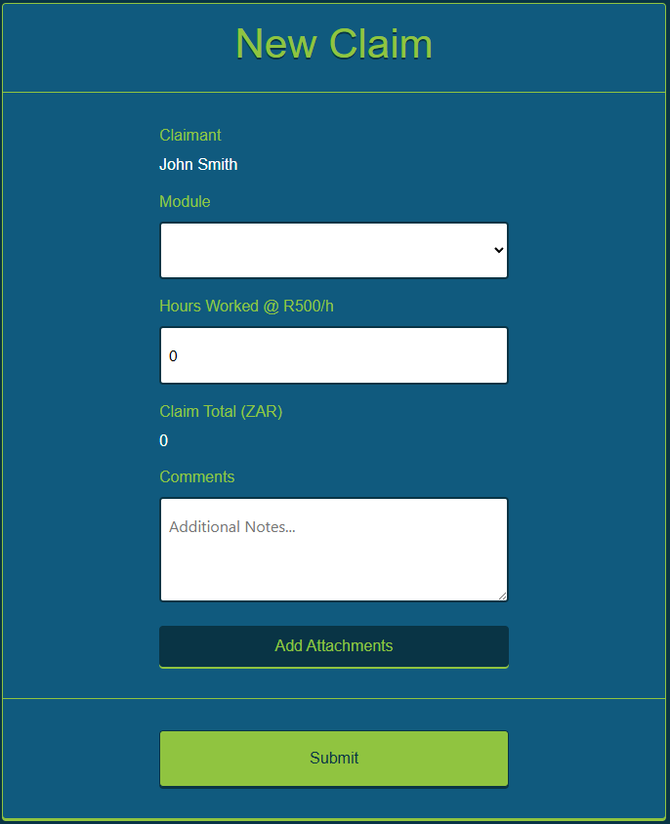
Solution: Simplified Claim Submission
Limited Module Options
Minimum 2 inputs, Maximum 4 inputs
Lecturer need only provide
  The module relevant to their claim
  Hours worked
  (optional) Comments and supporting documents which might help in verifying the validity of the claim

Slide 6
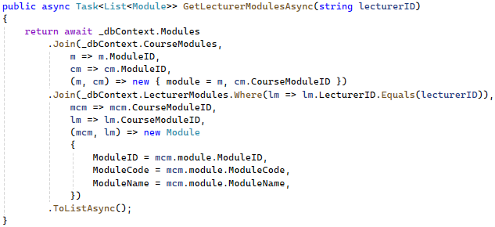
Solution: Pre-validated module selection
Simple
  Lecturers only see modules they teach, and not all modules offered by the institution
Safe
  Lecturers cannot claim against modules which they don’t teach

Slide 7
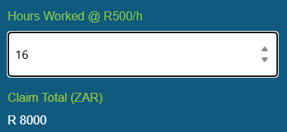
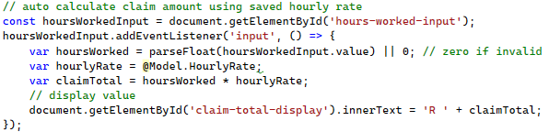
Solution: Simplified claim valuation
Lecturers’ hourly rate
  Set by HR during onboarding
  Pulled from database during claim creation
Claim value auto-calculates using stored hourly rate and entered hours worked
Saves time for both claim and verification
Reduces manual verification tasks

Slide 8
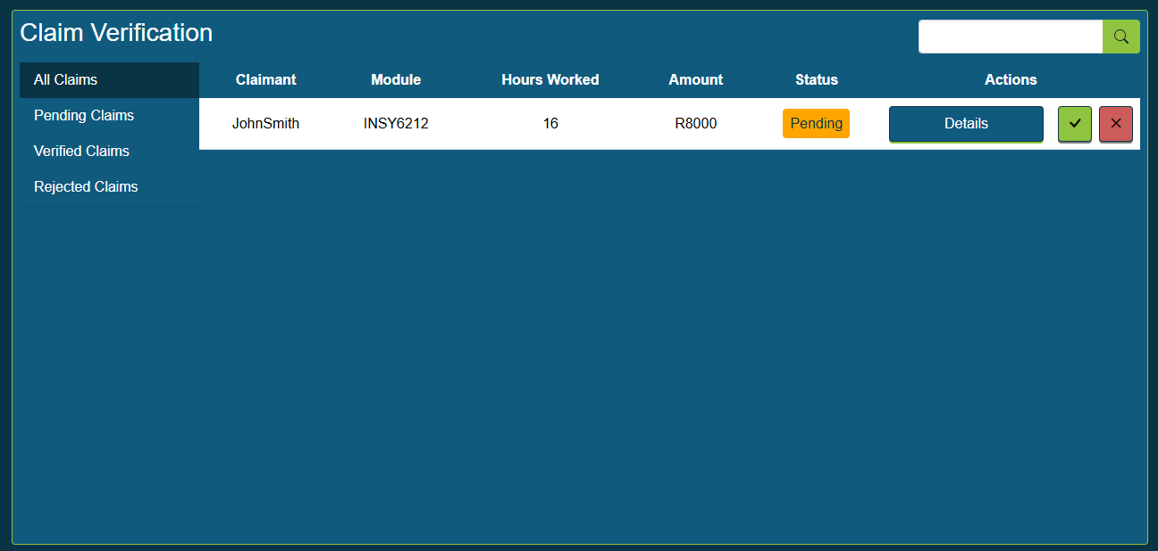
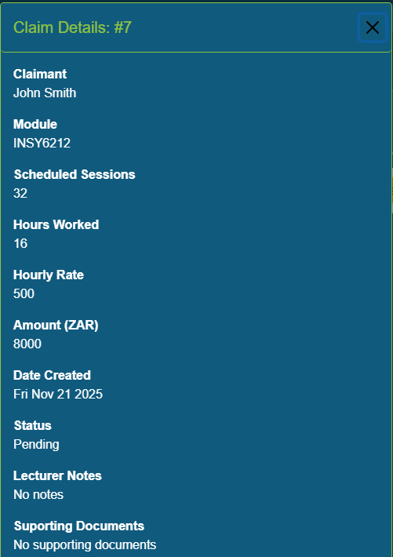
Solution: simplified approval
Approval can be granted based on data at a glance
Claim detail can be viewed, including attached documents, if further scrutiny is required.

Slide 9
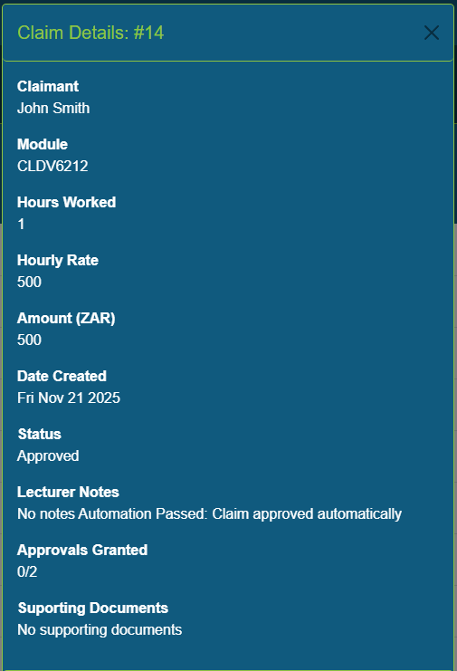
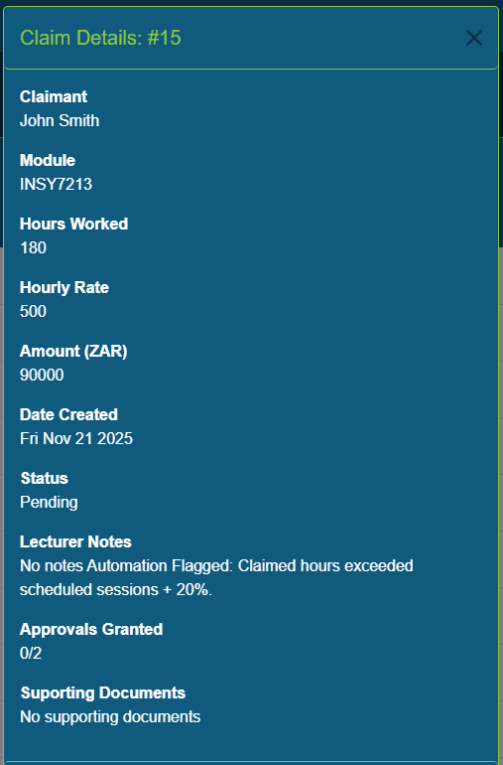
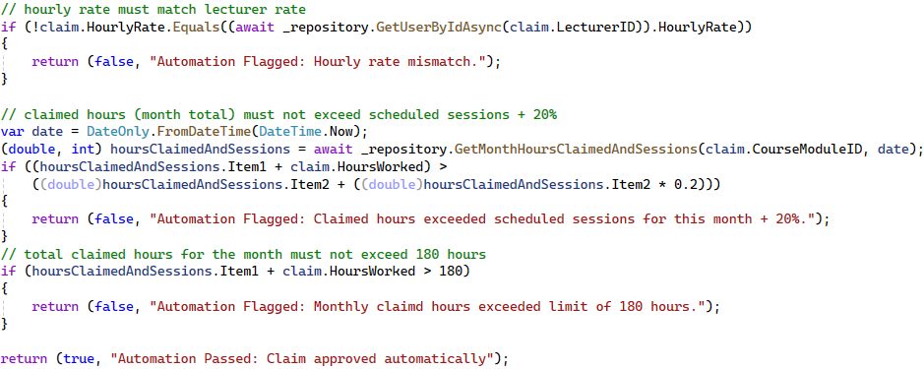
Solution: automated approval
The system can auto-approve claims that fall within certain criteria.

Slide 10
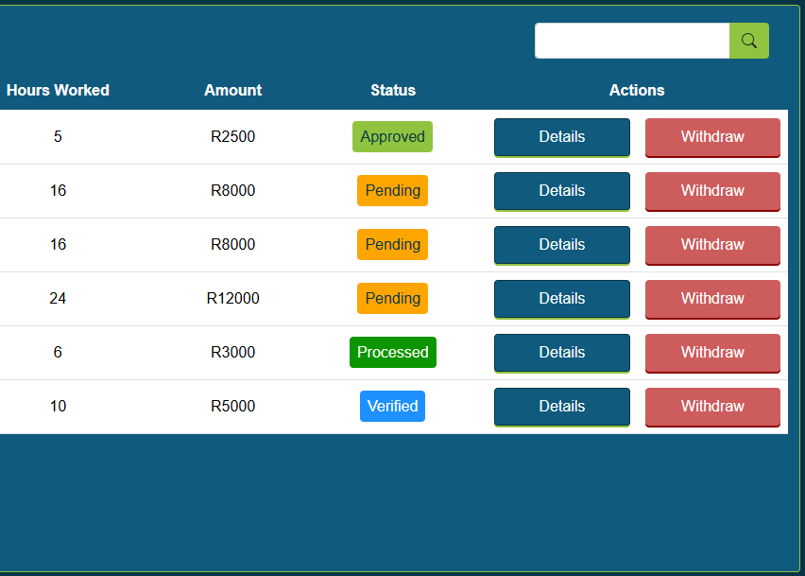
Solution: transparent approval process
Claim status is updated at each step of the process
Status is updated in real-time, allowing the lecturer to see updates as they happen
Reduces queries regarding claim approvals

Slide 11
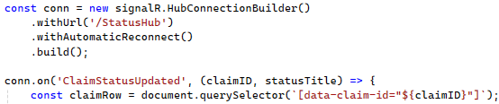
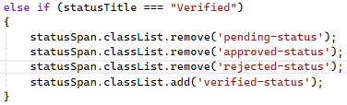

Real-time status updates with SignalR
Lecturer View
1. Client connects to SignalR Hub
2. Define callback function for when ‘ClaimStatusUpdated’ triggers
3. When callback function runs, update the UI for the relevant claim
Approval Controller
1. Send status to update notice method when claim is verified
2. SignalR hub notifies clients of the event

Slide 12
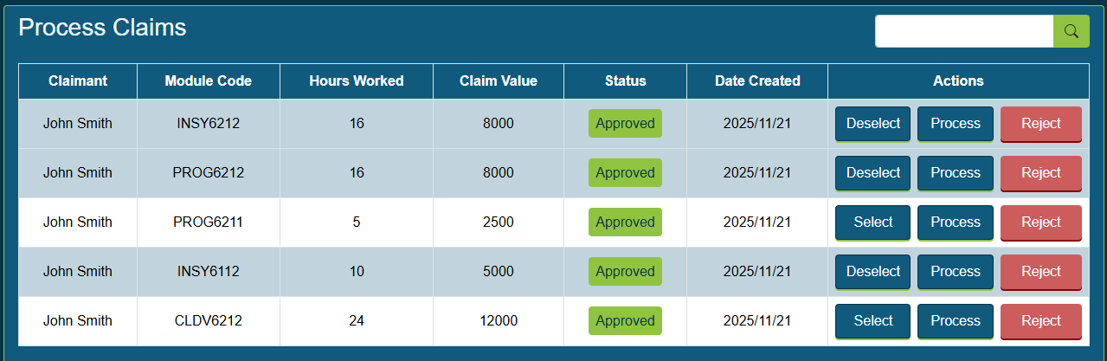
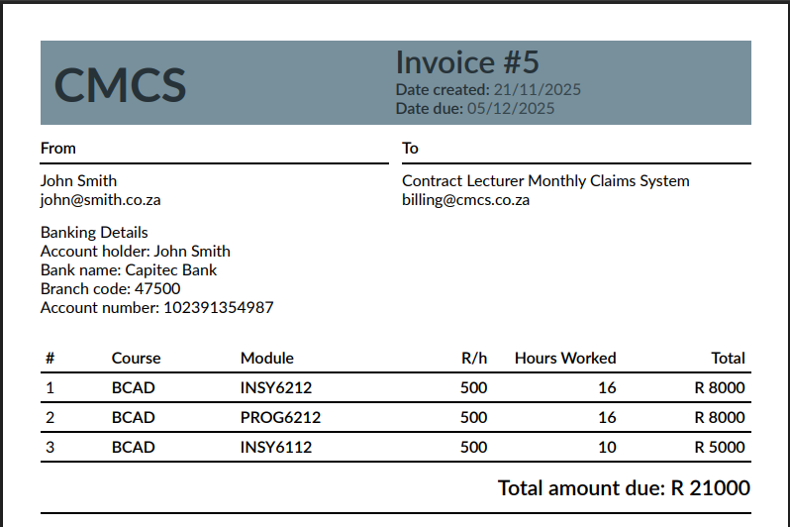
Solution: automated invoice generation
HR can select one or more claims to process. This completes the claim process and automatically generates an invoice, stored in the system database.

Slide 13
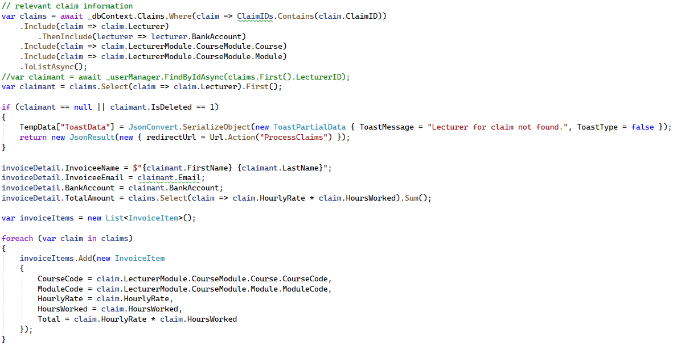
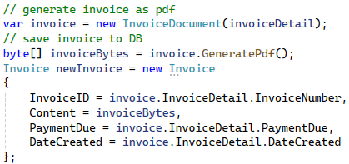
Invoice Generation
Claim and relevant lecturer data is read from the database
The data fed to a QuestPDF Document class which defines the invoice template
The document content is saved to the database with information like invoice number, date created, and due date.

Slide 14
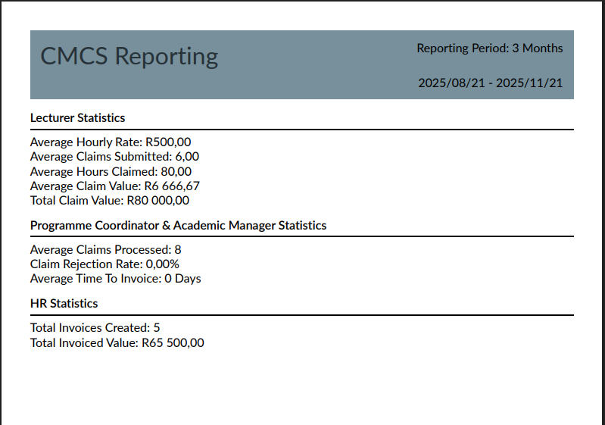
Solution: User and business insights
HR can generate statistics report documents for
  All time
  3 Months
  6 Months
  12 Months

Slide 15
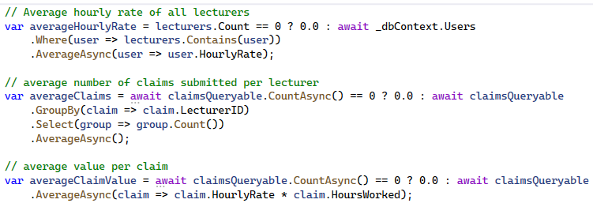
Solution: User and business insights
Lecturer Statistics
  Average hourly rate
  Average hours claimed
  Average number of claims per lecturer
  Average claim value
Claim Statistics
  Rejection rate
  Average time from claim submission to processing completion
  Total claims processed
  Total number of invoices
  Total amount invoiced
Statistics gathering example

Slide 16
Solution: User and business insights
Further insights possible
  Per approver productivity metrics
  Lecturer rates per module/course
  Cost efficiency suggestions
  Module pricing guidance based on lecturer cost

Slide 17
Conclusion
The CMCS
  Empowers lecturers
  Enhances institution productivity and operational efficiency
  Delivers actionable business insights

